Slide 1


Artificial Intelligence as a driver for Innovation in Official Statistics Francesco Pugliese, Central Directorate for Methodology and Design of Statistical Processes, Istat ARTIFICIAL INTELLIGENCE AND OFFICIAL STATISTICS: THE NEW FRONTIER OF INNOVATION Caserta | 12 November 2025 | University of Campania “Luigi Vanvitelli” | Department of Mathematics and Physics | Abramo Lincoln Street, 5 QUINDICESIMA GIORNATA ITALIANA DELLA STATISTICA
Istat | DCME | MEC

Slide 2
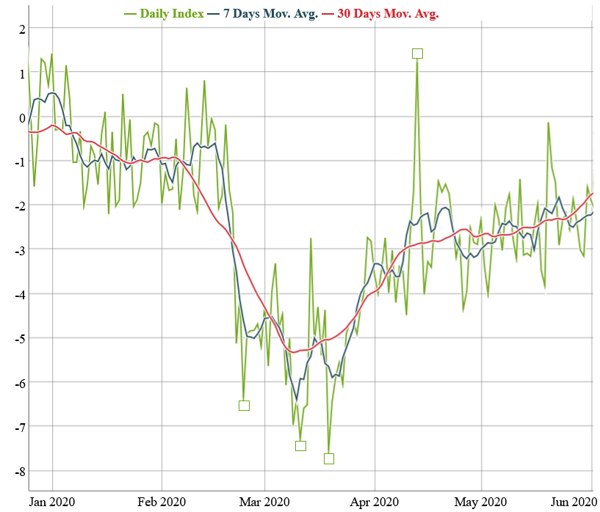
AI for Sentiment Analysis
ISTAT’s SMEI January-May 2020: the Covid outbreak in Italy
The Social Mood on Economy Index (SMEI) is developed by ISTAT
Measures the Italian sentiment on economy
Extracts the sentiment from Twitter data
The sentiment analysis is conducted using a lexicon-based, unsupervised, approach

Slide 3
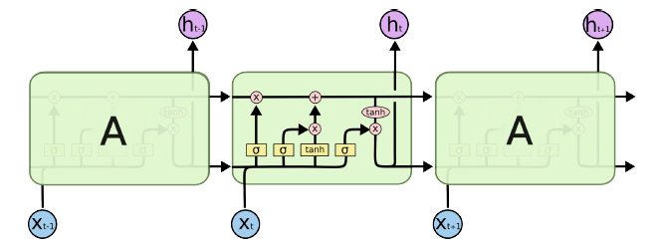
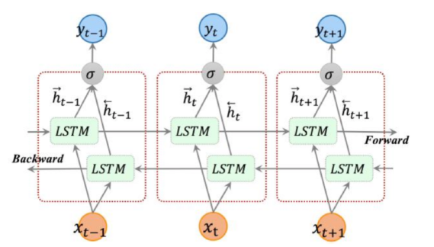
Materials and Methods: BiLSTM
Our classification model is a Bidirectional Long short-term memory (BiLSTM). LSTMs are a type of RNN able to process long sequences of data whereas BiLSTM are able to understand the left context and right context of sequences.
A LSTM memory cell is composed of 4 units exactly: an input gate, an output gate, a forget gate and a self-recurrent neuron.

Slide 4
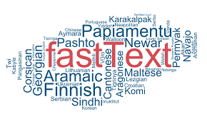
Materials and Methods: FastText
Our Word Embeddings Model is FastText which is an evolution of Word2Vec.
FastText enables to quickly train models on large corpora
FastText make use of hierarchical soft-max based which is able to noticeably drop computational complexity and can be trained on more than one billion words in less than ten minutes using a standard multicore CPU.

Slide 5
Why a new Index?
ISTAT’s Index (SMEI) needed a revision to deal with new events (Covid pandemic)
The proposed model may have a higher adaptability to new information
The proposed model is a neural network that has been trained on a set of labelled Tweets that do not contain references to the pandemic

Slide 6
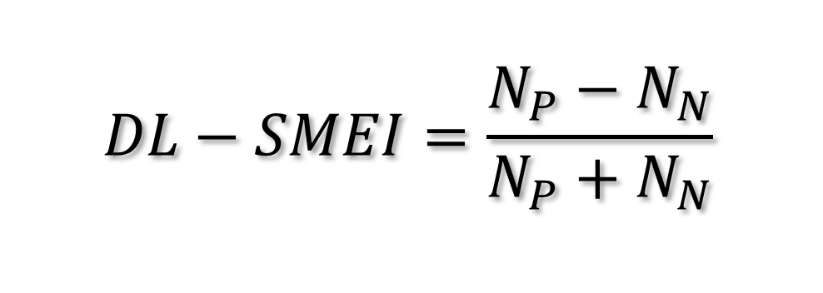
Computed daily using the sentiment predicted by the model on a set of tweets
The sentiment is predicted using a neural network
The set of tweets is the same used by ISTAT for the SMEI
Computed for the first half of 2020
The proposed Index:
DL-SMEI
$$DL−SMEI=\frac{N_{P}−N_{N}}{N_{P}+N_{N}}$$

Slide 7
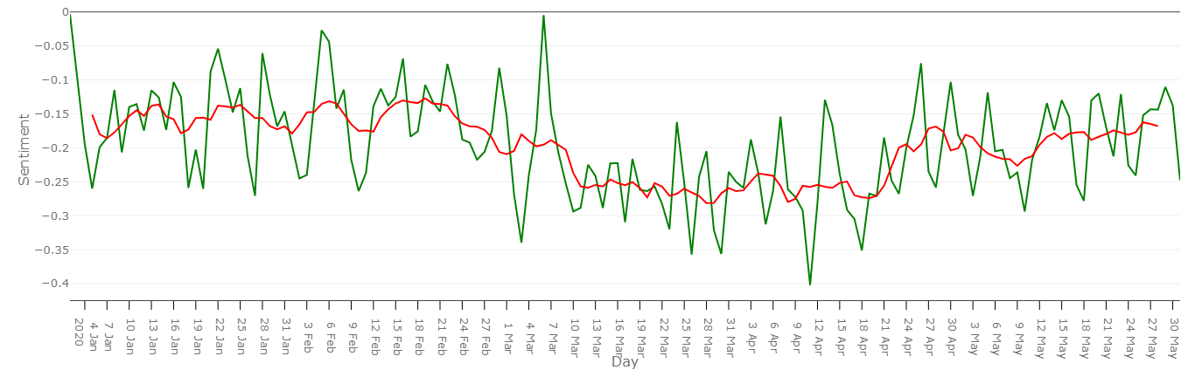
The proposed Index (DL-SMEI)
+ 10.3% negatives
-0.157
-0.260
-0.190
Notes:
Capture a persistent decline in the sentiment following the imposition of lockdown on 7th March 2020
Highlights three macro-periods with different levels of sentiment
Is always negative

Slide 8
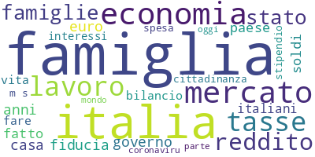
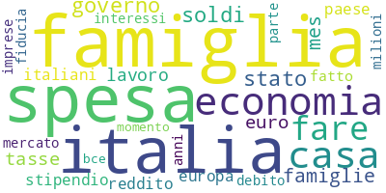
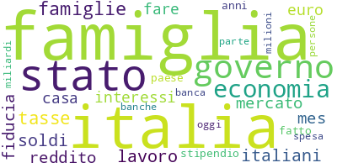
1st January – 7th March
8th March – 21st April
22nd April – 31st May

Slide 9
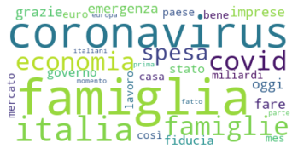
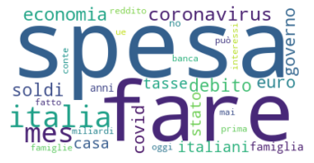
Focus on second period (8th March – 21st April)
Positive words
Negative words

Slide 10
Maximum and Minimum points
Notes:
To find furhter confirmation about this evidence, we should look at the minimum and maximum points

Slide 11
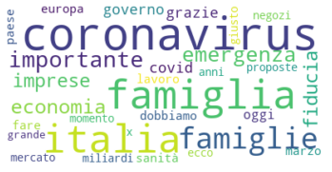
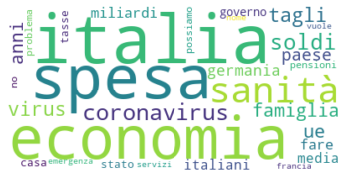
Second Maximum on the 6th March
Positive words
Negative words

Slide 12
Limitations
Misclassification of Covid: updated training set may increase accuracy
Unrepresentativeness of Social Media data
Difficult to evaluate the accuracy of the Index: need of a reference measure
Future Directions
Label a more accurate Istat's training set
Adopt more powerful and "state-of-art" models in Sentimen Analysis such as Bert and its derivations.

Slide 13
AI for Land Cover
GOALS
Land Cover (LC) statistics and maps are a very important statistical product. As they require a big effort to be created, the idea is to build an automatic system that processes satellite images in order to generate:
Automatic Land Cover Estimates
Automatic Land Cover Maps

Slide 14

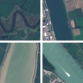
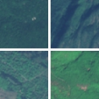
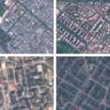
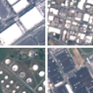
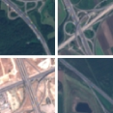

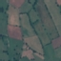
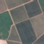
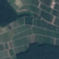


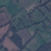
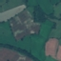
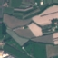
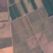



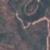

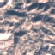
AI for Land Cover
ANNUAL CROP
RIVER
FOREST
EuroSAT dataset (https://github.com/phelber/eurosat):
Based on Sentinel-2 satellite images
27000 geo-referenced and labeled image patches (each one of 64x64 pixels)
10 different Land Use and Land Cover classes, with 2000-3000 images per class
RGB (8-bit) and Multi-Spectral (13 spectral bands, 16-bit) versions available
RESIDENTIAL
INDUSTRIAL
HIGHWAY
PASTURE
PERMANENT CROP
SEA LAKE
HERBACEOUS VEGETATYION

Slide 15
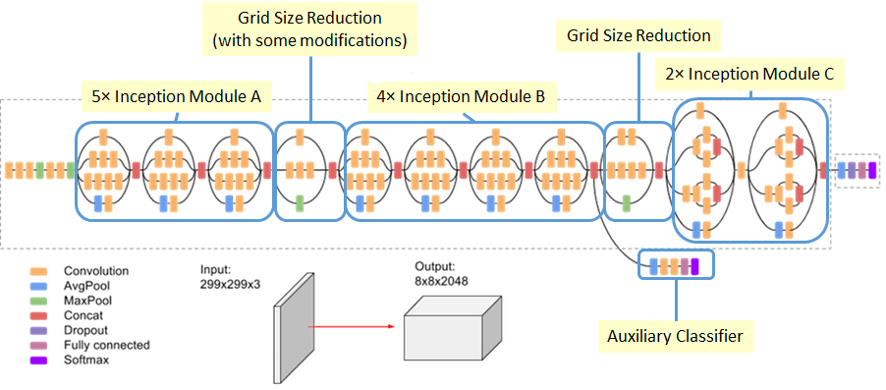
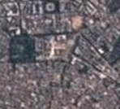
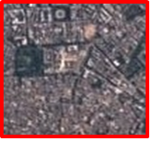
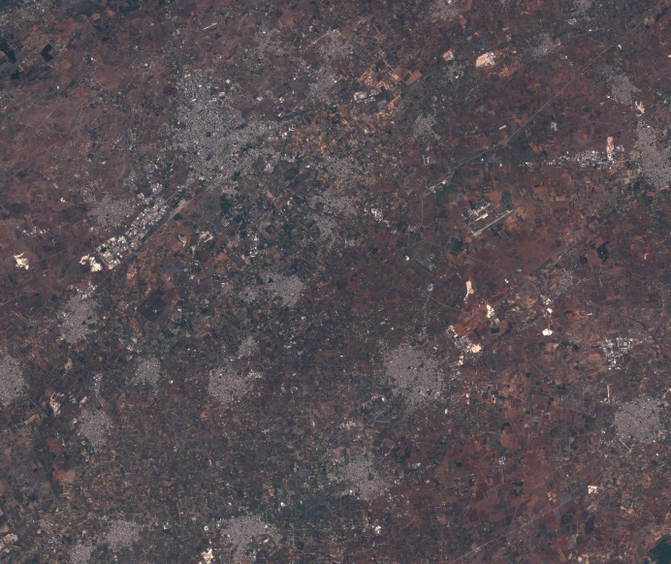
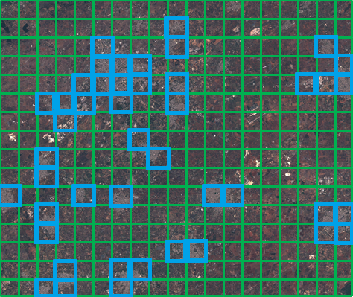
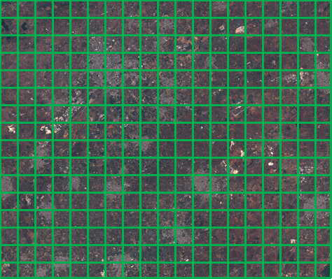
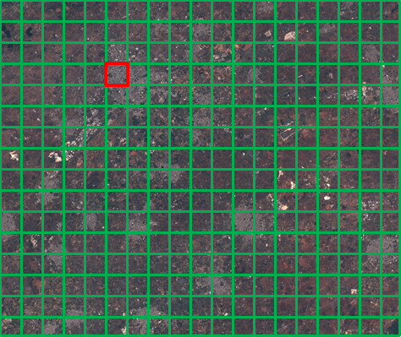
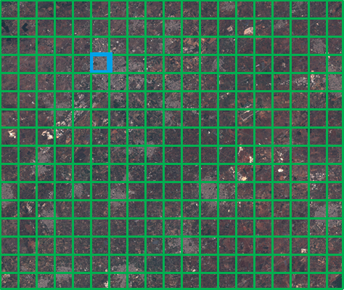
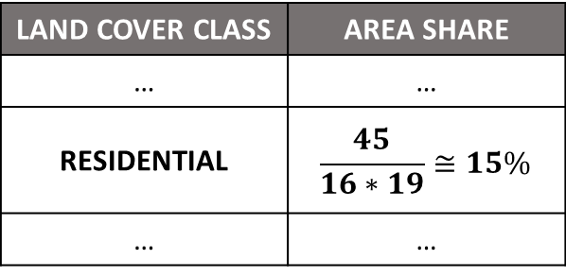
AI for Land Cover
Classify-and-Count
Approach
CNN: Inception-V3 Archite
RESIDENTIAL
Input Satellite Image

Slide 16
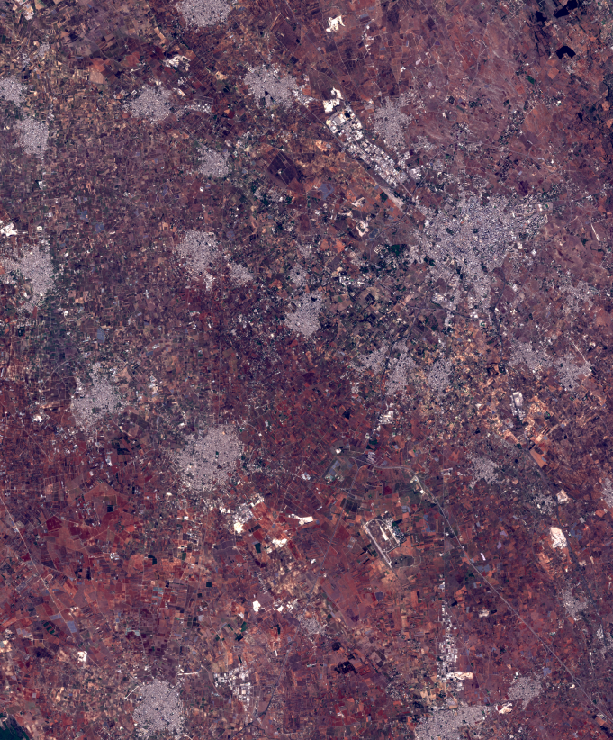
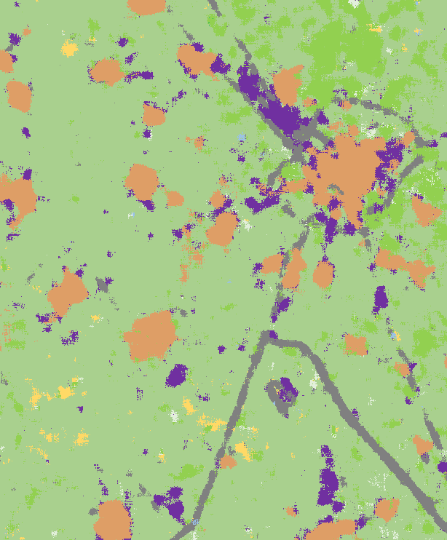
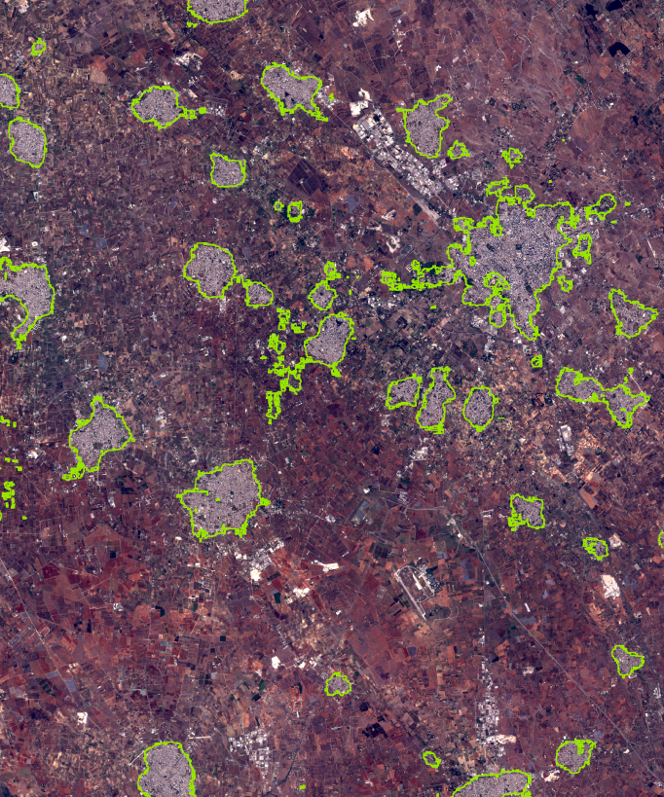
AI for Land Cover
[A]
The ‘Lecce image’ (751 km²)
[B]
Automated LC map derived from the ‘Lecce image’
[C]
Edge line of the ‘Residential’ class derived from [B] overlaid on [A]

Slide 17
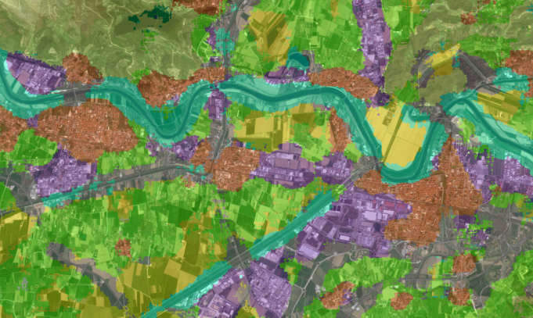
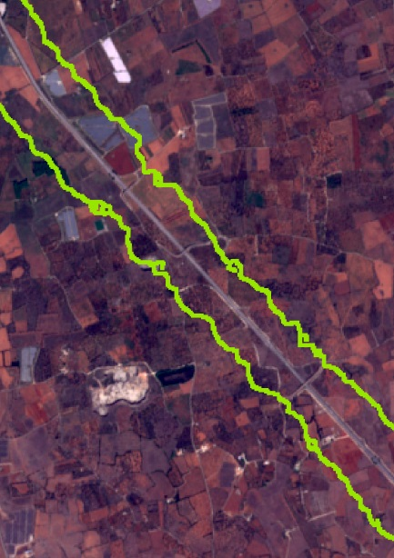
AI for Land Cover
~500 m
~600 m
[D]
A detailed view of the course of the Arno River (cropped from the ‘Pisa image’, 443 km²) overlaid with a semitransparent version of the corresponding automated LC map
[E]
A highway fragment from the ‘Lecce image’ overlaid with the edge line of the ‘Highway’ class

Slide 18

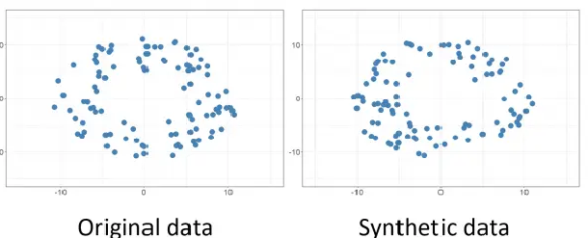
AI for the generation of Synthetic Data
With the digitalization of information and the increasing accessibility of administrative data, the amount of data to be handled has grown substantially in recent years. This raises significant concerns about data protection and privacy since the disclosure of sensitive information can pose serious risks to individuals, institutions, and public administrations.
Synthetic data are artificially created datasets intended to replicate the statistical characteristics and structure of real data, while preventing the exposure of sensitive or personally identifiable information.

Slide 19

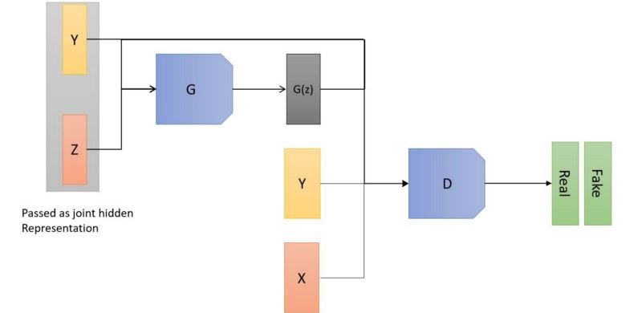
AI for the generation of Synthetic Data
Keep in mind! Synthetic data do not necessarily reproduce the atomic data (categorical, numerical, etc) from the original source. Synthesis capability might rely rather on the relationships between different kind of entities, such as people and objects, school and neighborhoods, or users and cellular antennas.
In this study, the analyzed data relate to the frequency and attributes of trips and vacations undertaken by residents of Italy. They originate from the Istat Trips and Holidays survey, as a module of the Household Budget Survey (HBS) which collects information on the tourism flows of residents. This information includes journeys made for leisure or work, both domestically and internationally.
In the WP13’s Istat PoC of AI/ML Essnet project, we compared different AI methods: CT-GAN, VAEs, DP-CTGAN, SMOTENC, Random Forest, XGBoost

Slide 20
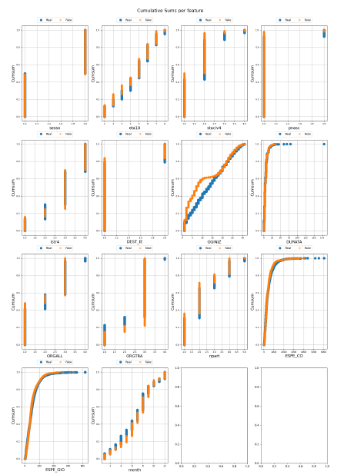
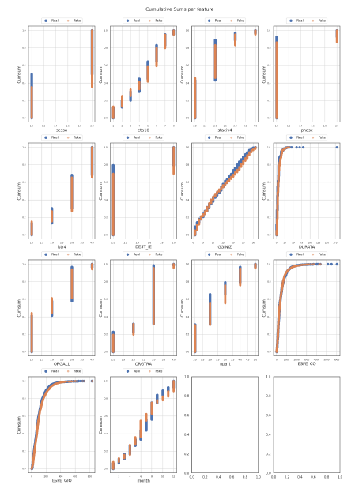
AI for the generation of Synthetic Data
Note: In the original distribution itself, the values are not sums of previous values. Only in the cumulative sum version do the values accumulate.
It is evident from the cumulative distributions that the less effective methods, such as Random Forest or XGBoost, are less efficient on categorical variables, where they often fail to reproduce the categories, i.e. the domain values of these variables.
Variational Autoencoder (VAE)
CT-GAN

Slide 21
AI for the generation of Synthetic Data
As we can observe, apart from SMOTENC which tends to reproduce the data exactly, the best methods seem to be the deep learning–based ones such as CTGAN and VAE, as they achieve high accuracy but not identical to the original dataset, as expected. In fact, during the synthetic data generation process something is always lost in terms of the properties of the data being reproduced.
Model | Accuracy | F1-Score | Recall
Original Data | 0.964516848 | 0.964516848 | 0.964516848
RF | 0.660685592 | 0.660685592 | 0.660685592
XGB | 4.46349e-05 | 4.46349e-05 | 4.46349e-05
SMOTENC | 0.992813783 | 0.992813783 | 0.992813783
DPCTGAN | 4.46349e-05 | 4.46349e-05 | 4.46349e-05
VAE | 0.892385288 | 0.892385288 | 0.892385288
CTGAN | 0.896134619 | 0.896134619 | 0.896134619

Slide 22
Conclusions and Next Steps
Conclusions

Slide 23
References
Goodfellow, I., Pouget-Abadie, J., Mirza, M., Xu, B., Warde-Farley, D., Ozair, S., ... & Bengio, Y. (2014). Generative adversarial nets. Advances in neural information processing systems, 27.
Xu, Lei, et al. "Modeling tabular data using conditional gan." Advances in neural information processing systems 32 (2019).
Wu, J.; Plataniotis, K.; Liu, L.; Amjadian, E.; Lawryshyn, Y. Interpretation for Variational Autoencoder Used to Generate Financial Synthetic Tabular Data. Algorithms 2023, 16, 121. https://doi.org/10.3390/a16020121

Slide 24
Thanks
FRANCESCO PUGLIESE | francesco.pugliese@istat.it

